Slide 1

Commuting in New York/New Jersey
An Analysis of Rider Data

Slide 2
Citibike
In May of 2013, NYC launched Citibike, one of the largest operating bike-share systems in the United States.
Have since expanded operations to include Jersey City and The Bronx.
Named after lead sponsor Citigroup.
Acquired by Lyft in September, 2018.
Manhattan. Brooklyn. Queens. The Bronx. Jersey City. Hoboken.
Source: www.citibikenyc.com

Slide 3
Assumptions and Limitations
No post-covid data
Only the data in regards to Jersey City, New Jersey
Reason for trip not given

Slide 4
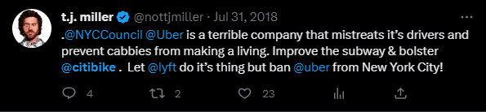
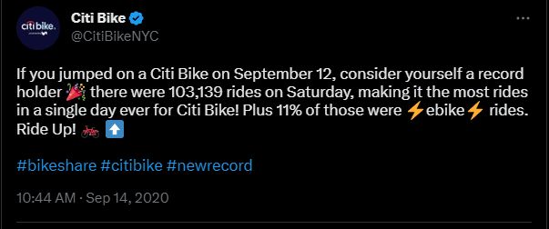
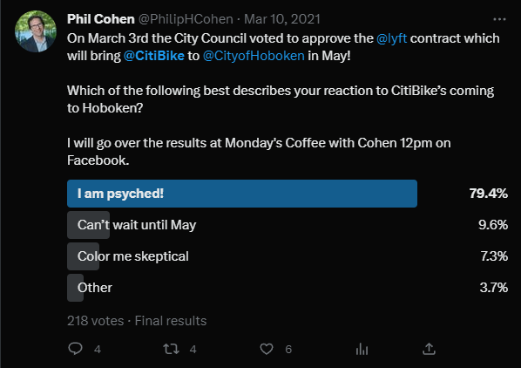

Slide 5
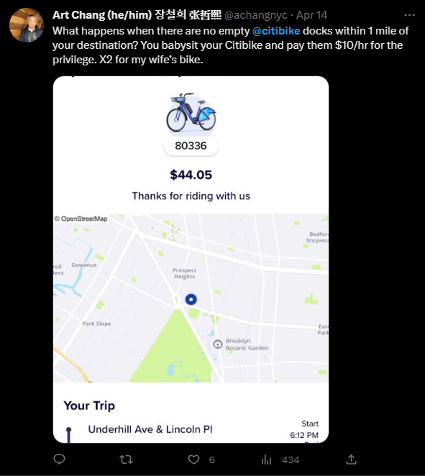
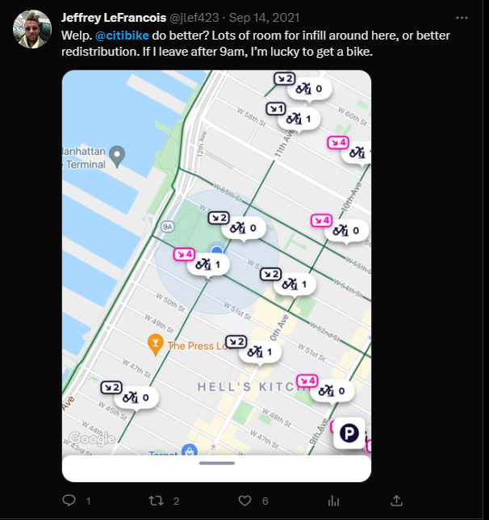

Slide 6
Popular Routes
Provide insights on user trends
Highlight areas on interest
Predict station demand and supply

Slide 7
Grove Street PATH (Port Authority Trans-Hudson)
Newark and World Trade Center Line
Journal Square and 33rd Street Line
Professionals Living in Jersey City commuting to NYC or Newark
Tourists without other means of transportation

Slide 8
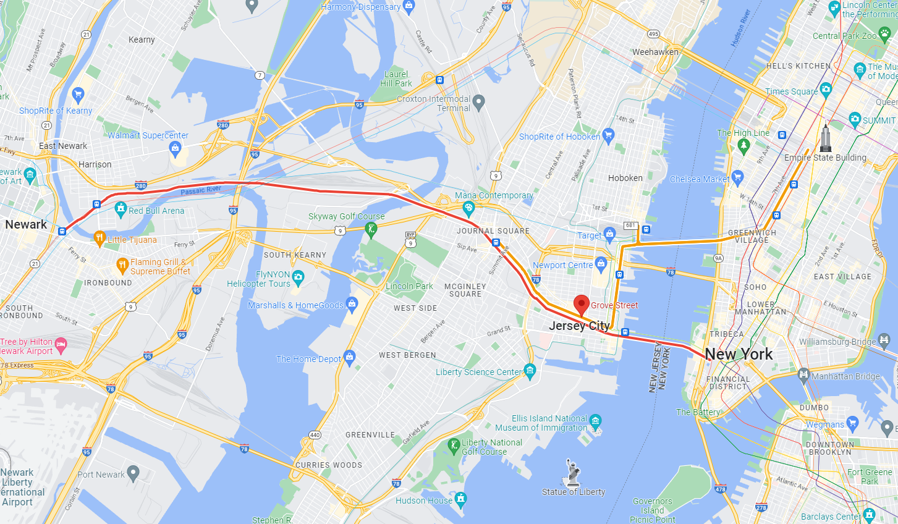

Slide 9
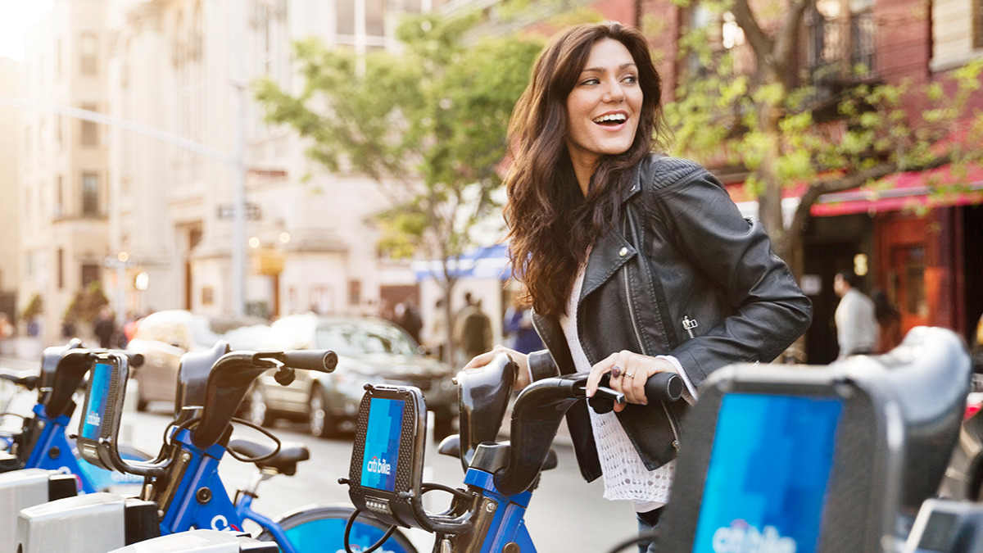
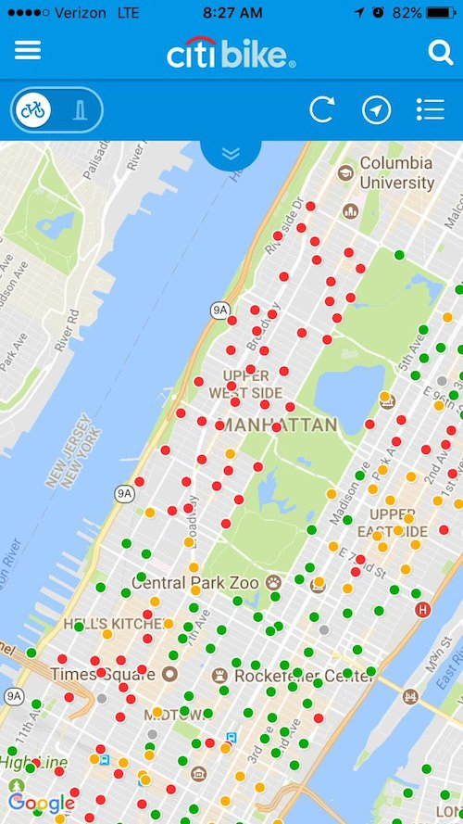
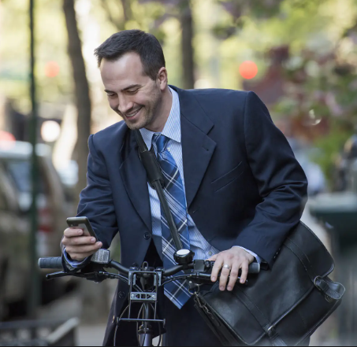

Slide 10
Main Predictor of Availability:
Seasonality and Time Series Data
Summer is the busiest, Winter is the slowest
Peak hours are standard (8-9am, 5-6pm)
Transport HUBs have highest inflow

Slide 11
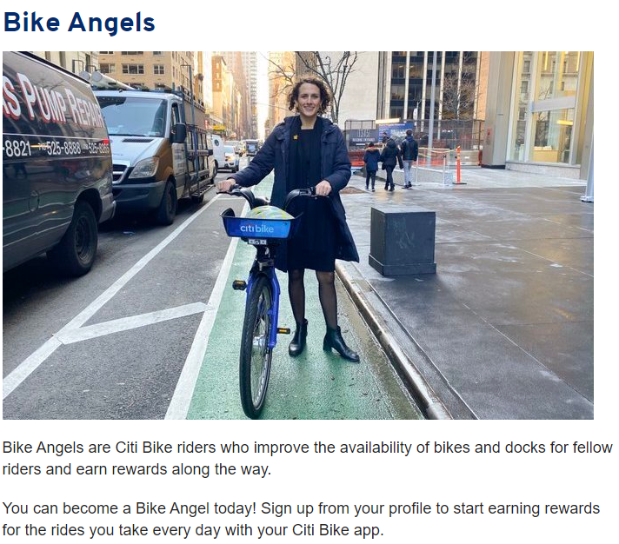
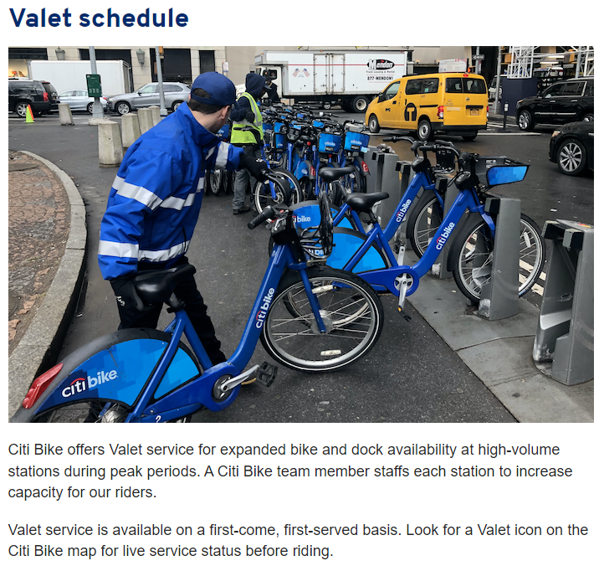
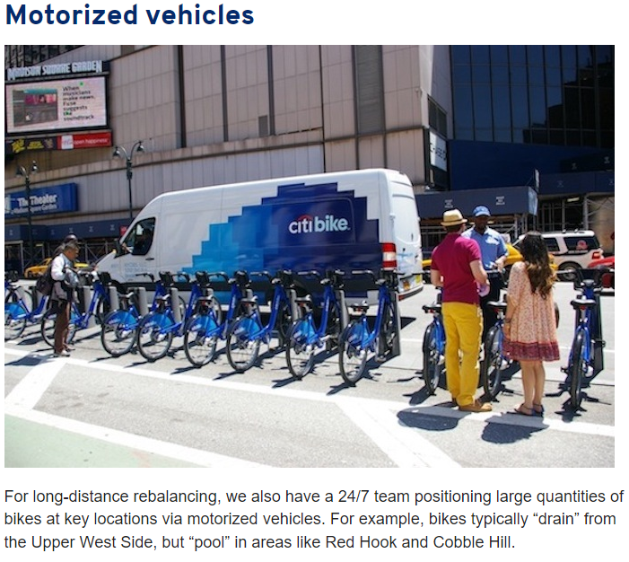
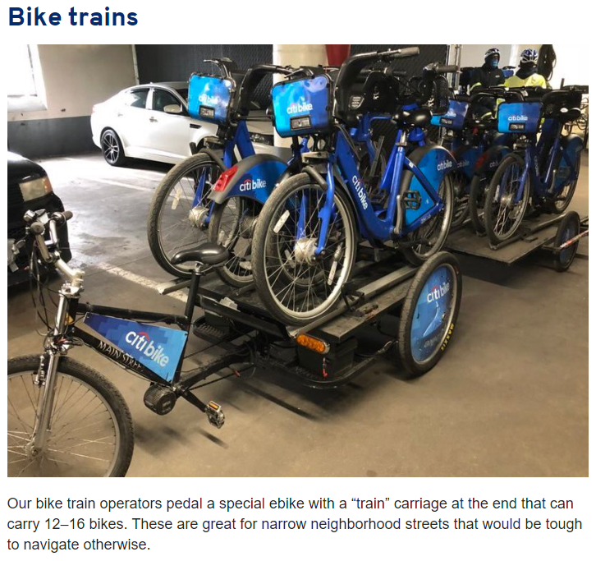
https://ride.citibikenyc.com/blog/rebalancing-the-citi-bike-system

Slide 12
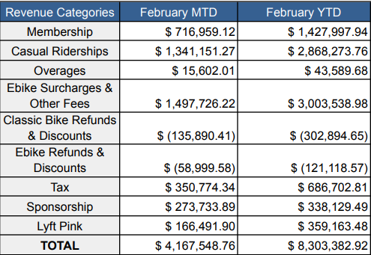
Revenue (Based on February 2023 Monthly Report)
60,426 Rides per day
Each bike was used 1.82 times a day
Total annual membership stands at 141,908
26,170 bikes in the fleet on the last day of the month.
Citi Bike technicians conducted 35,648 bicycle inspections and repairs throughout the month and responded to 9 reported cases of vandalism.
The total revenue for the month was 4,167,548.76 with 883,451.02 from membership and user fees and 273,733.89 from sponsorship.
Source: https://mot-marketing-whitelabel-prod.s3.amazonaws.com/nyc/February-2023-Citi-Bike-Monthly-Report.pdf

Slide 13
Cost (Based on 2017 Projection)
According to city Department of Transportation Commissioner Polly Trottenberg, adding to the fleet costs approximately $6,000 per bicycle.
Citibike’s Reasoning:
-Unlike other bike share companies that offer the rides wherever the bicycles are located at any given moment, Citi Bike has stations strategically placed in locations determined to be high use areas. Compiling data to show where the bike stations should go costs a lot of money, as does establishing a network for the bikes. That includes employing statisticians to understand ridership and ways to improve the system, as well as app developers to create and maintain an effective experience for riders.
-The program "rebalances" bikes to make sure they are where they should be: where there's lots of demand.
-Hiring bike mechanics to ensure bikes are riding safely on the road and to do preventive maintenance where necessary.
-Employing operations and finance staff to guarantee that the Citi Bike network complies with local laws and regulations.
-Maintaining a backend software system to securely manage thousands of financial transactions per day and protect customers' identities.
-Running a 24/7 hotline for riders, with tips on the system and safety support.
Source: https://www.silive.com/news/2017/04/heres_why_it_costs_6k_per_citi.html

Slide 14
Cost (Based on 2017 Projection)
According to the DOT, a city-wide system would require close to 80,000 bikes: more than six times the program's 2017 projection. New bikes can only be deployed at a rate of about 2,000 bikes per year, and the cost hovers around $6,000 per bike.
12,800 bikes in the fleet at the end of Dec 2019 (--------------------) ( $46.7M)
14,813 bikes in the fleet at the end of Dec 2020 ($12,078,000) ( $62.0M )
22,826 bikes in the fleet at the end of Dec 2021 ($48,078,000) ( $87.6M )
26,100 bikes in the fleet at the end of Dec 2022 ($19,644,000) ($106.4M)
Source: https://mot-marketing-whitelabel-prod.s3.amazonaws.com/nyc/Citi-Bike-Monthly-Report.pdf
Source: https://gothamist.com/news/city-council-debates-publicly-funding-citi-bike-expansion-to-far-flung-neighborhoods

Slide 15
Takeaways
Citibike is privately owned and does not receive public funding
Expansion will be slow and costly
There are already measures in place to improve product availability and visibility
Membership and ridership is steadily increasing
The most impactful solution in the short term is to expand on existing operations

Slide 16
Actionable Items Include
Redistributing bike inventory from lower traffic neighborhoods before demand spikes
Removing low performing stations in favor of opening new stations in high demand areas or establishing them in between popular routes.
Better incentives instead of free trips to our Bike Angels.
Social Media Campaigns to raise awareness.

Slide 17
Q&A?

